Slide 1
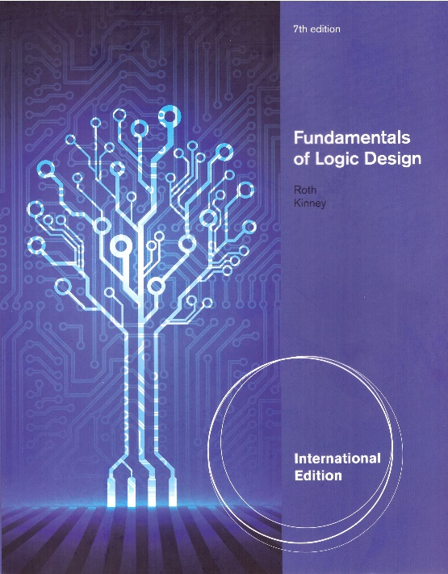
Unit 4
Applications of Boolean Algebra/ Minterm and Maxterm Expansions
This chapter in the book includes:
Objectives
Study Guide
4.1 Conversion of English Sentences to Boolean equations
4.2 Combinational Logic Design Using a Truth Table
4.3 Minterm and Maxterm Expansions
4.4 General Minterm and Maxterm Expansions
4.5 Incompletely Specified Functions
4.6 Examples of Truth Table Construction
4.7 Design of Binary Adders and Subtracters

Slide 2
Objectives
Conversion of English Sentences to Boolean Equations
Combinational Logic Design Using a Truth Table
Minterm and Maxterm Expansions
General Minterm and Maxterm Expansions
Incompletely Specified Functions (Don’t care term)
Examples of Truth Table Construction
Design of Binary Adders(Full adder) and Subtracters

Slide 3
4.1 Conversion of English Sentences to Boolean Equations
- Steps in designing a single-output combinational switching circuit
Find switching function which specifies the desired behavior of the circuit
Find a simplified algebraic expression for the function
Realize the simplified function using available logic elements
1. F is ‘true’ if A and B are both ‘true’ → F = AB

Slide 4
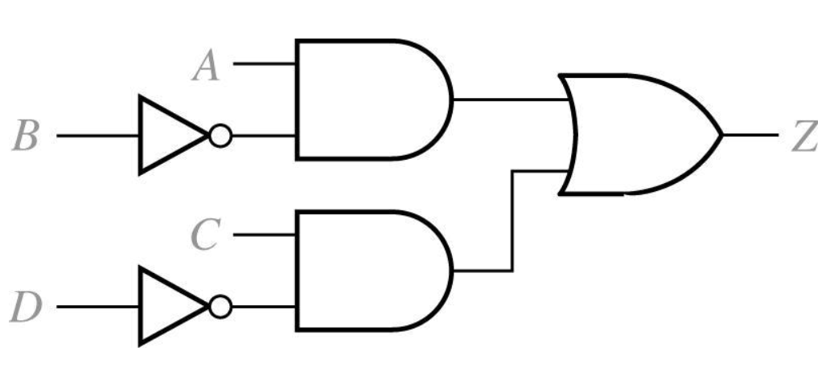
4.1 Conversion of English Sentences to Boolean Equations
1. The alarm will ring (Z) iff the alarm switch is turned on (A) and the door is not closed (B’), or it is after 6 PM (C) and window is not closed (D’)
2. Boolean Equation
3. Circuit realization

Slide 5
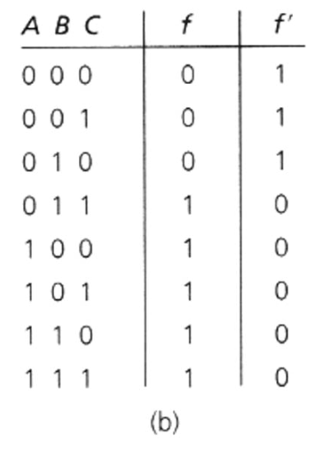
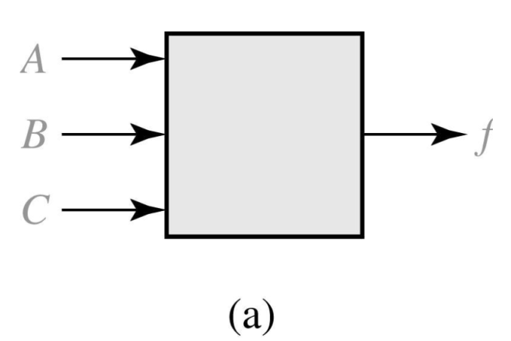
4.2 Combinational Logic Design Using a Truth Table
Combinational Circuit with Truth Table
Using the expression for f=1 →

Slide 6
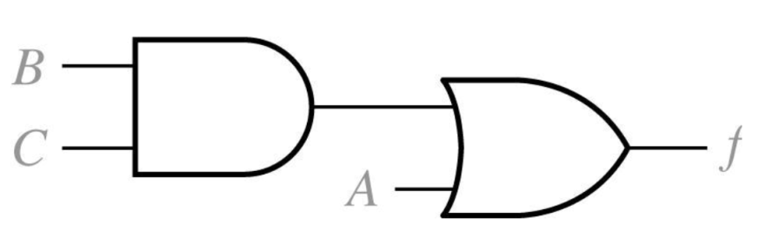
4.2 Combinational Logic Design Using a Truth Table
Original equation →
Simplified equation →
Circuit realization →

Slide 7

4.2 Combinational Logic Design Using a Truth Table
Combinational Circuit with Truth Table
Using the expression for f=0 →
When expression for f ’=1 →
and take the complement of f ‘

Slide 8
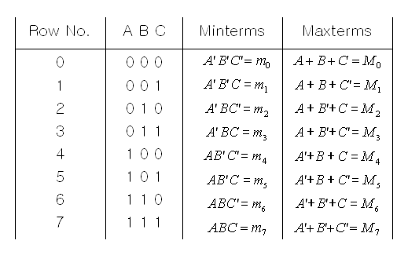
4.3 Minterm and Maxterm Expansions
literal is a variable or its complement (e.g. A, A’)
Minterm, Maxterm for three variables

Slide 9
4.3 Minterm and Maxterm Expansions
Minterm of n variables is a product of n literals in which each variable appears exactly once in either true (A) or complemented form(A’), but not both. (→ m0)
Minterm expansion
Standard Sum of Product →

Slide 10
4.3 Minterm and Maxterm Expansions
Maxterm of n variables is a sum of n literals in which each variable appears exactly once in either true (A) or complemented form(A’) , but not both.(→ M0)
Maxterm expansion
Standard Product of Sum →

Slide 11
4.3 Minterm and Maxterm Expansions
Minterm and Maxterm expansions are complement each other

Slide 12
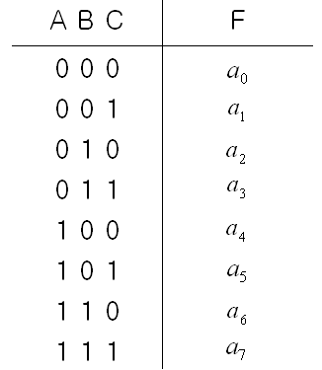
4.4 General Minterm and Maxterm Expansions
General truth table for 3 variables
a_{i} is either ‘0’ or ‘1’
Minterm expansion for general function
a_{i} =1, minterm m_{i} is present
a_{i} =0, minterm m_{i} is not present
Maxterm expansion for general function
a_{i} =1, a_{i} + M_{i} =1 , Maxterm M_{i} is not present
a_{i} =0, Maxterm is present

Slide 13
4.4 General Minterm and Maxterm Expansions
→ All minterm which are not present in F are present in F ‘
→ All maxterm which are not present in F are present in F ‘

Slide 14
4.4 General Minterm and Maxterm Expansions
If i and j are different, m_{i} m_{j} = 0
Example
f
=
∑
m
(
0
,
2
,
3
,
5
,
9
,
11
=
∑
)
and
f
m
(
0
,
3
,
9
,
11
,
13
,
14
)
1
2

Slide 15
Conversion between minterm and maxterm expansions of F and F’
DESIRED FORM
 | Minterm Expansion of F | Maxterm Expansion of F | Minterm Expansion of F’ | Maxterm Expansion of F’
Minterm Expansion of F |  | Maxterm nos. are those nos. not on the minterm list for F | List minterms not present in F | Maxterm nos. are the same as minterm nos. of F
Maxterm Expansion of F | Minterm nos. are those nos. not on the maxterm list for F |  | Minterm nos. are the same as maxterm nos. of F | List maxterms not present in F
GIVEN FORM

Slide 16
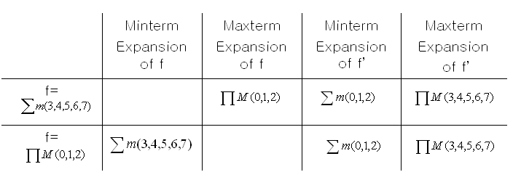
Conversion between minterm and maxterm expansions of F and F’
Example

Slide 17
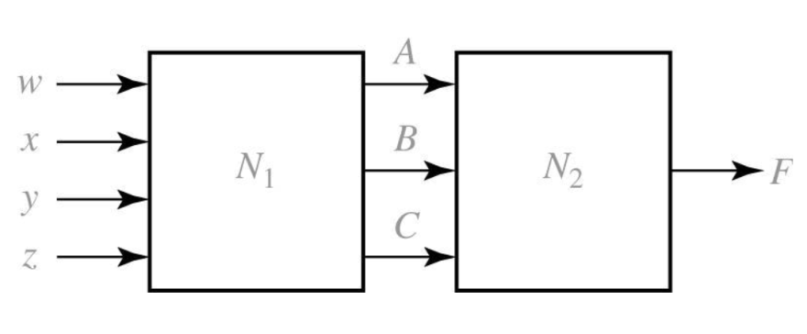
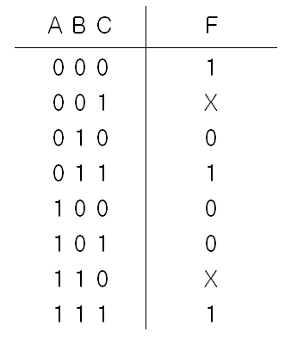
4.5 Incompletely Specified Functions
Truth Table with Don’t Cares
If N₁ output does not generate all possible combination of A,B,C, the output of N₂ (F) has ‘don’t care’ values.

Slide 18
4.5 Incompletely Specified Functions
Finding Function
Case 1: assign ‘0’ on X’s
Case 2: assign ‘1’ to the first X and ‘0’ to the second ‘X’
Case 3: assign ‘1’ on X’s
→ The case 2 leads to the simplest function

Slide 19
4.5 Incompletely Specified Functions
Minterm expansion for incompletely specified function
Don’t Cares
Maxterm expansion for incompletely specified function

Slide 20
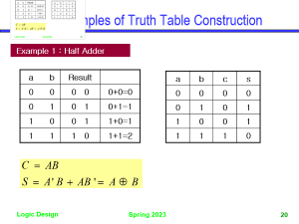
4.6 Examples of Truth Table Construction
Example 1 : Half Adder
a b | Result
0 0 | 0 0 | 0+0=0
0 1 | 0 1 | 0+1=1
1 0 | 0 1 | 1+0=1
1 1 | 1 0 | 1+1=2
a | b | c | s
0 | 0 | 0 | 0
0 | 1 | 0 | 1
1 | 0 | 0 | 1
1 | 1 | 1 | 0

Slide 21
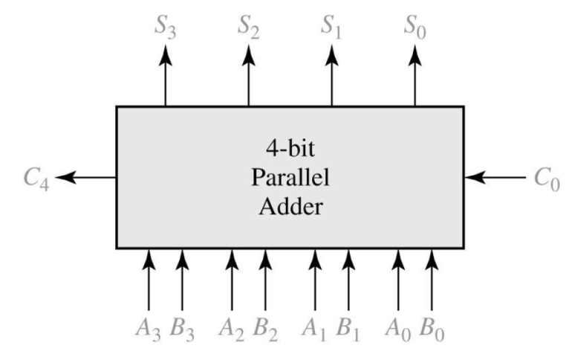
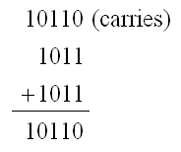
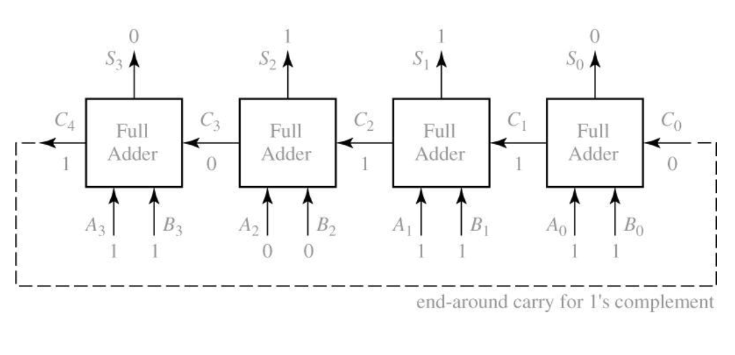
4.7 Design of Binary Adders and Subtracters
Binary Adder for 4-bit Numbers
Binary adder composed of four full adders ← Carry Ripple Adder

Slide 22
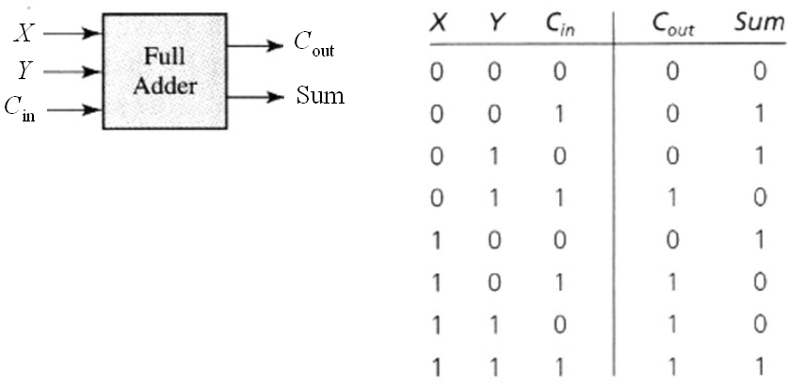
4.7 Design of Binary Adders and Subtracters
Truth Table for a Full Adder

Slide 23
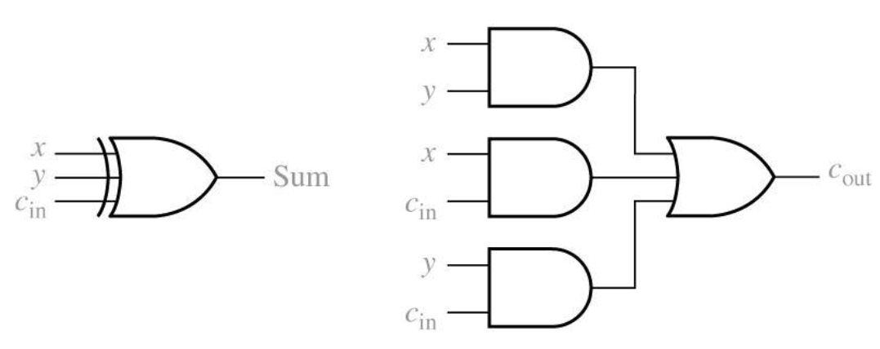
4.7 Design of Binary Adders and Subtracters

Slide 24
4.7 Design of Binary Adders and Subtracters
When 1’s complement is used, the end-around carry is accomplished by connecting C4 to C0 input.
Overflow(V) when adding two signed binary number

Slide 25
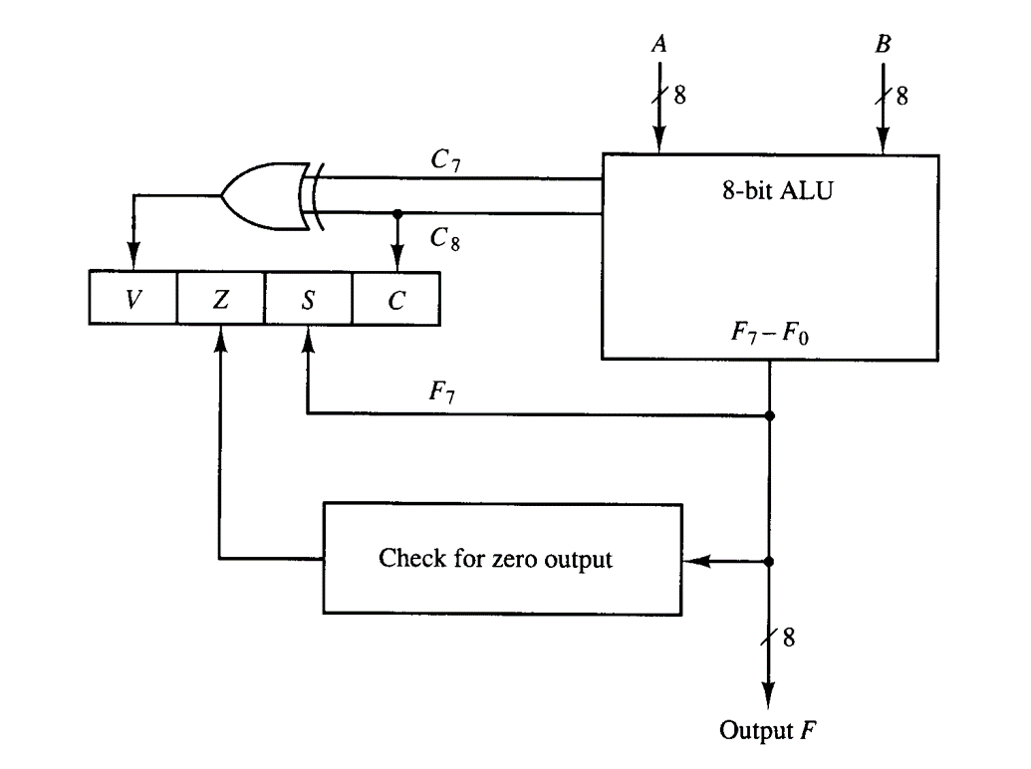
4.7 Design of Binary Adders and Subtracters
Overflow(V) detection using hardware

Slide 26
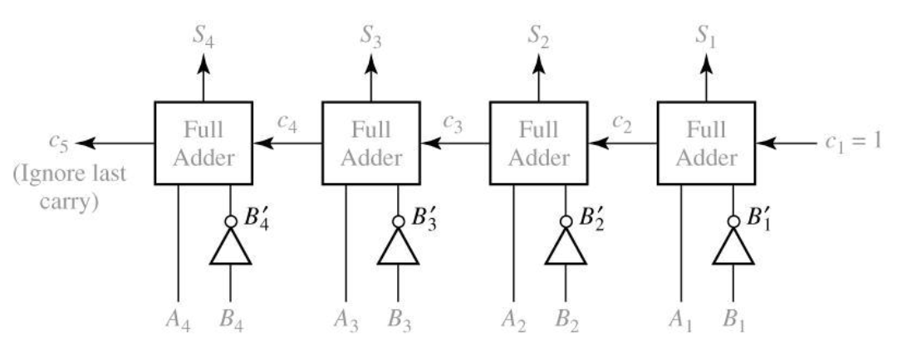
4.7 Design of Binary Adders and Subtracters
Binary Subtracter using full adder
Subtraction is done by adding the 2’s complemented number to be subtracted
2’s compleneted number : B’ + 1

Slide 27
4.7 Design of Binary Adders and Subtracters
d _{n}
d _{i}
d ₂
d ₁
b _{n+1}
Full Subtracter
Full Subtracter
Full Subtracter
Full Subtracter
b _{n}
b _{i+1}
b _{i}
b ₃
b ₂
b ₁=0
x _{n}
y _{n}
x ₃
y ₃
x ₂
y ₂
x ₁
y ₁
Truth Table for a Full Subtracter
x_{i} y_{i} b_{i} b_{i+1} d_{i}
0 0 0 0 0
0 0 1 1 1
0 1 0 1 1
0 1 1 1 0
0 0 0 1
1 0 1 0 0
1 0 0 0
1 1 1 1 1

